Slide 1
Sample Collection with Limited Fuel
Aryan Gupta
UNCC COAR Lab

Slide 2
Problem Statement
A robot must visit two locations on a while refueling in between

Slide 3
Why?
Jeff Bezos is creating a mars rover that must pick up element X for his new hair restoration cream from two mining sites but the mining sites are too far away to reach with a single battery charge
Pizza delivery company’s self driving car must deliver pizza to two local customers and it is running low on gas

Slide 4
Procedure
Detect obstacles on world
Construct map of viable travel areas
Create automata (FSM) of valid physical paths
Construct LTL formula
Convert LTL formula to automata
Calculate product automata to construct valid paths
Apply Dijkstra's algorithm to find shortest path
Strip states to physical paths
Draw path on world

Slide 5
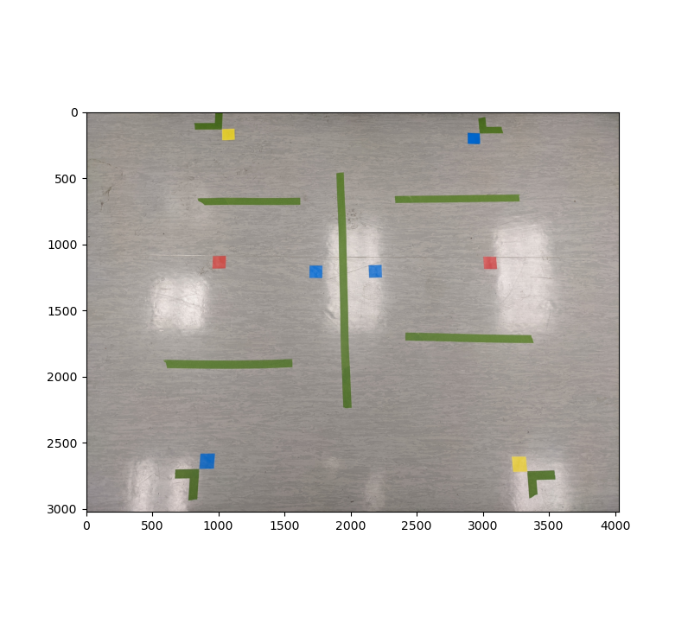
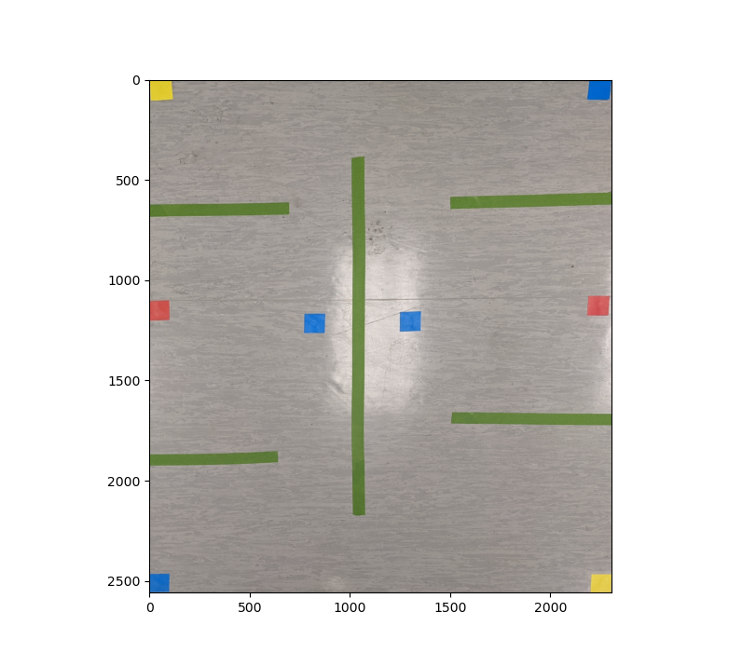
Detecting Obstacles on World
Perspective Warp
&
Crop
Original Image
Final Image

Slide 6
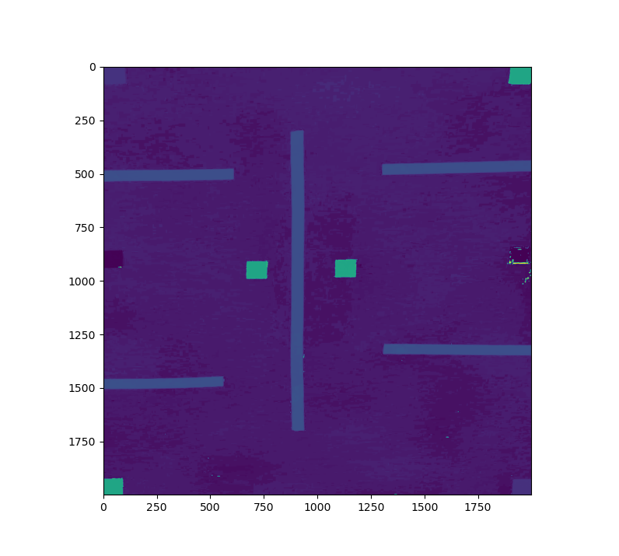
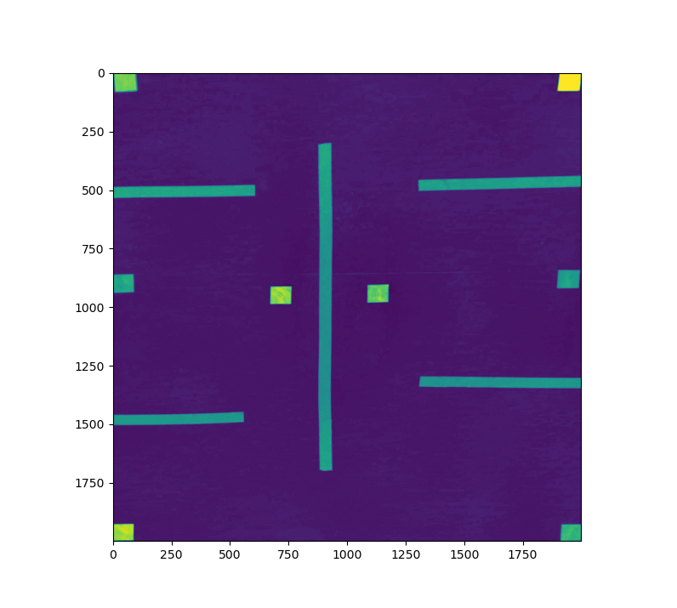
Detecting Obstacles on World
Hue Channel
Saturation Channel

Slide 7
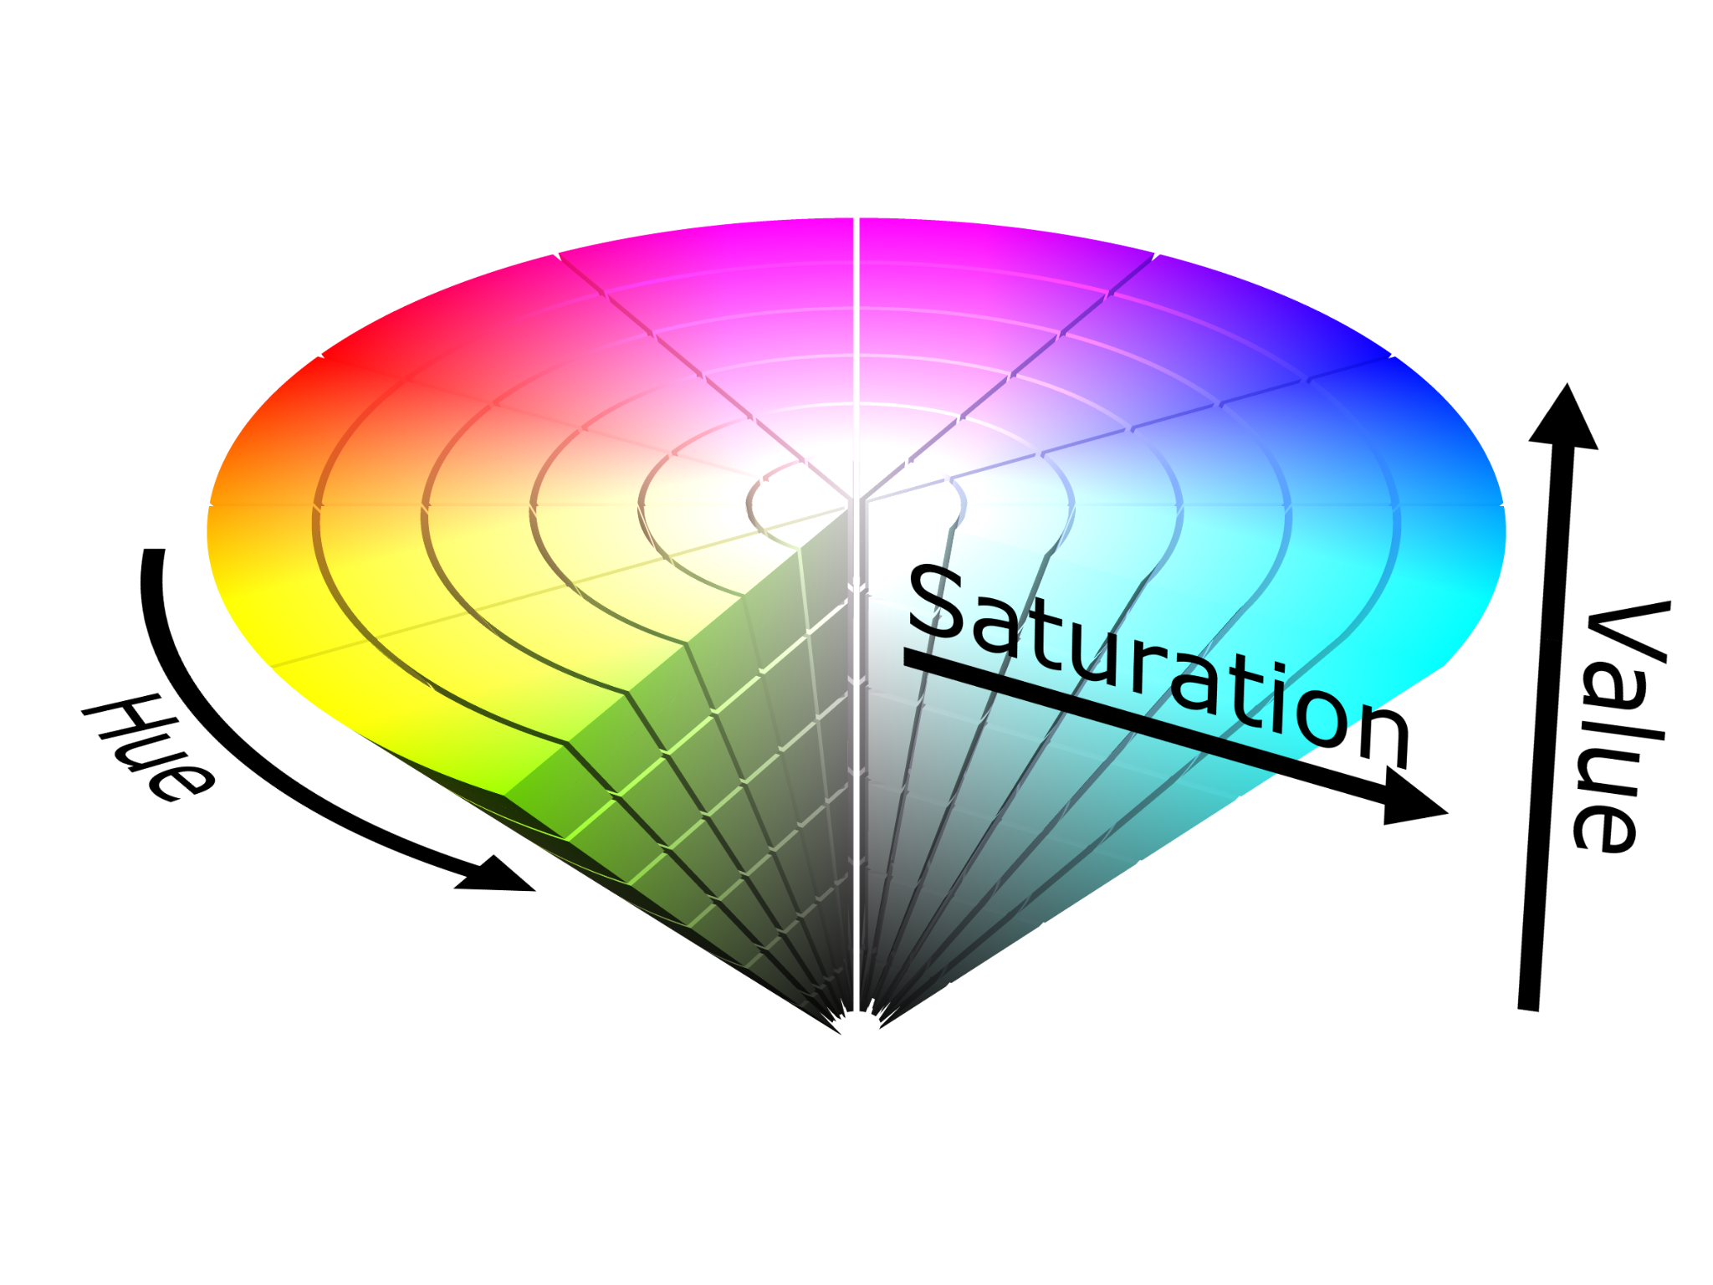
Detecting Obstacles on World
Hue Channel
Saturation Channel

Slide 8
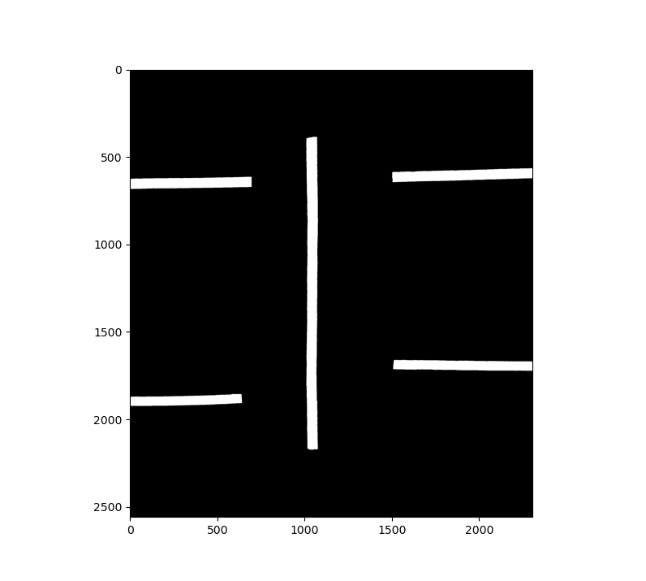
Detecting Obstacles on World
[40, 50]
Green Channel
H
AND
S
[100, 255]

Slide 9
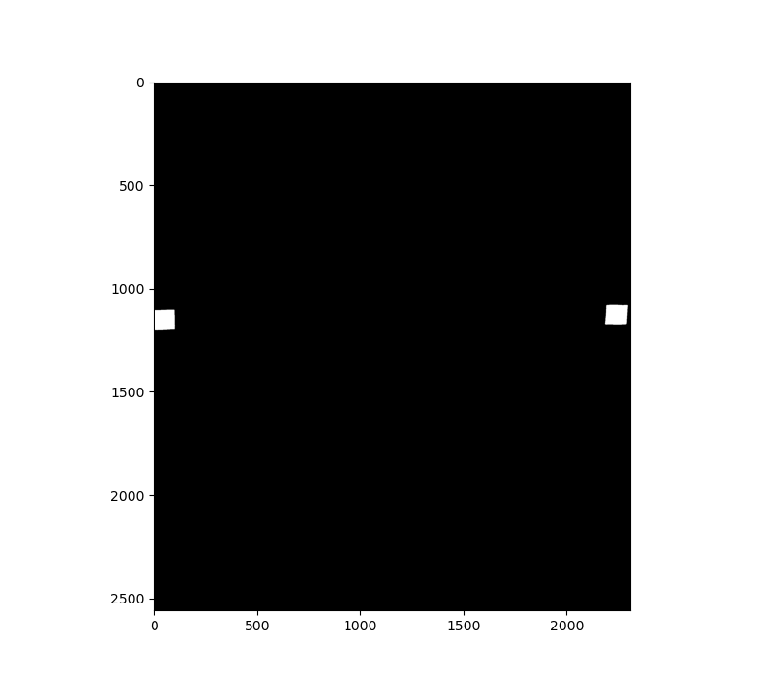
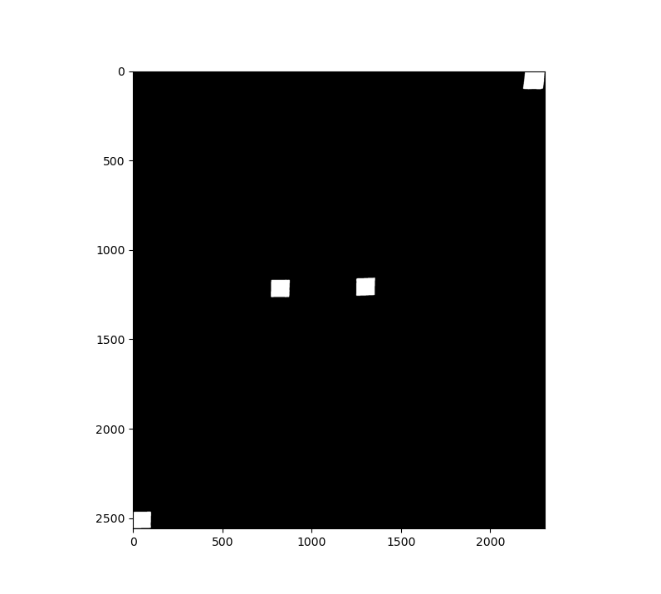
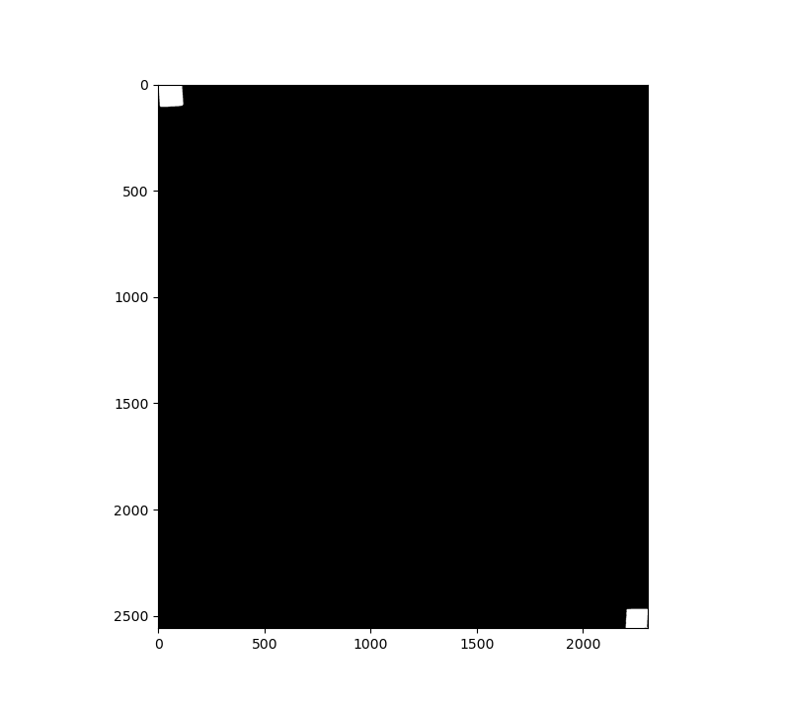
Detecting Obstacles on World
Red Channel
Hue ∈ [0, 5]
or
Hue ∈ [175, 180]
Green Channel
Hue ∈ [40, 50]
Blue Channel
Hue ∈ [100, 110]
Yellow Channel
Hue ∈ [20, 30]

Slide 10
Detecting Obstacles on World
Red Channel
Hue ∈ [0, 5]
or
Hue ∈ [175, 180]
Green Channel
Hue ∈ [40, 50]
Blue Channel
Hue ∈ [100, 110]
Yellow Channel
Hue ∈ [20, 30]

Slide 11
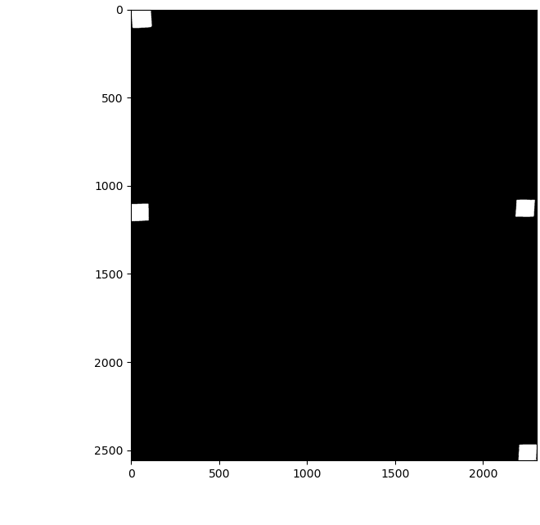
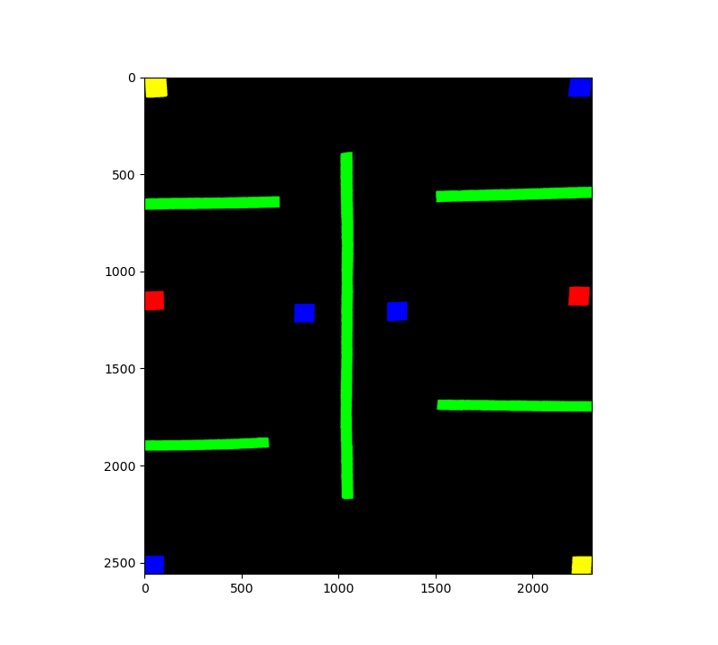
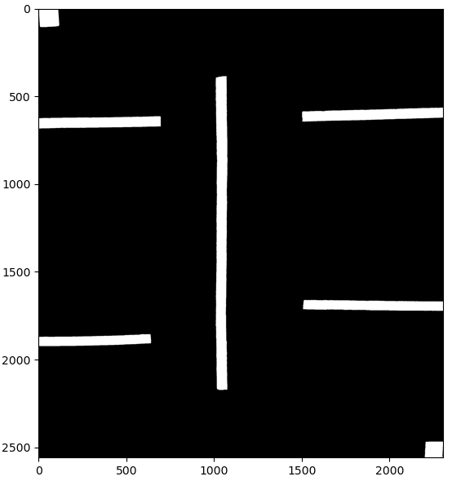
Detecting Obstacles on World
OR
R
OR
RGB
G
Y
B
Yellow = Red + Green

Slide 12
Detecting Obstacles on World

Slide 13
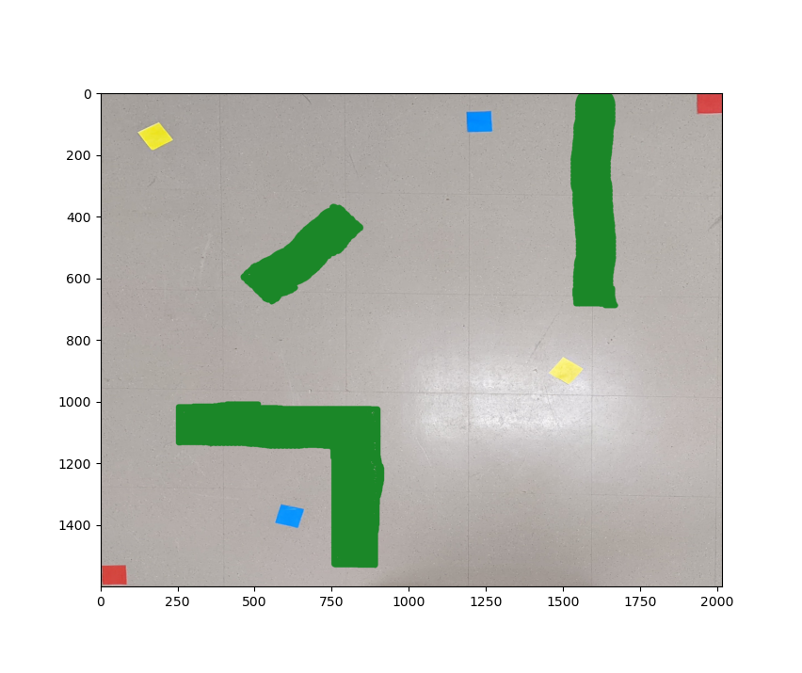
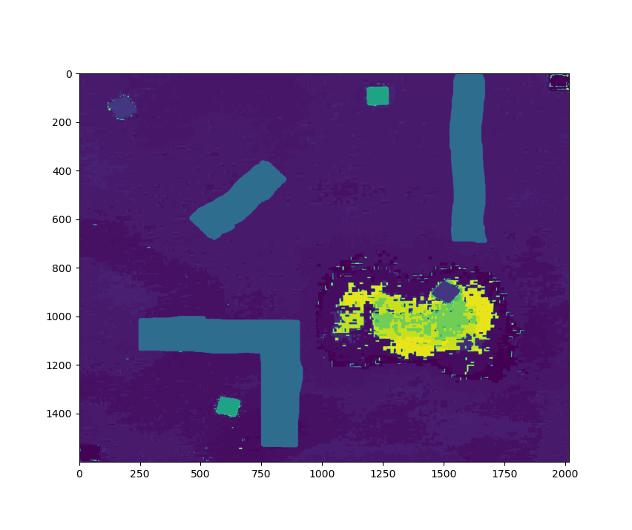
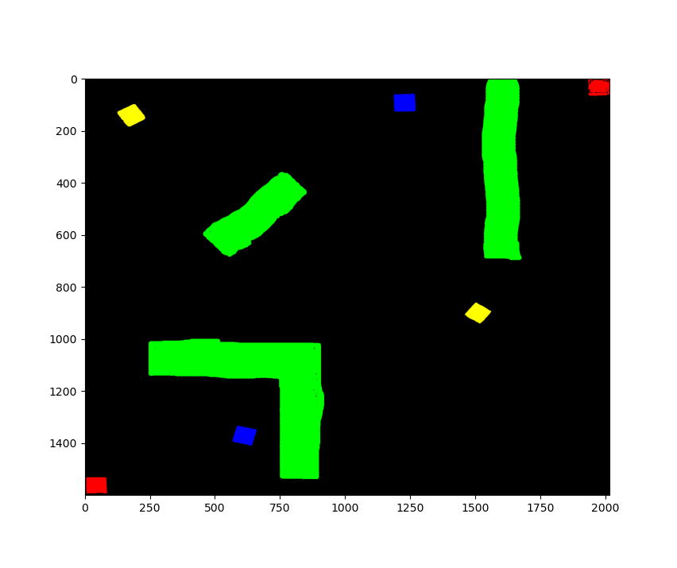
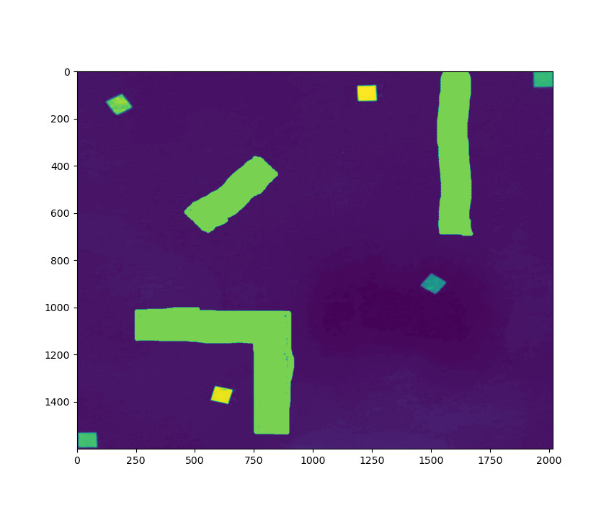
Detecting Obstacles on World
Original Image
Hue Channel
Final Image
m_{(x,y)} = True if h_{(x,y)} ∈ (250, 255] & s_{(x,y)} ∈ (100, 255]
Saturation Channel

Slide 14
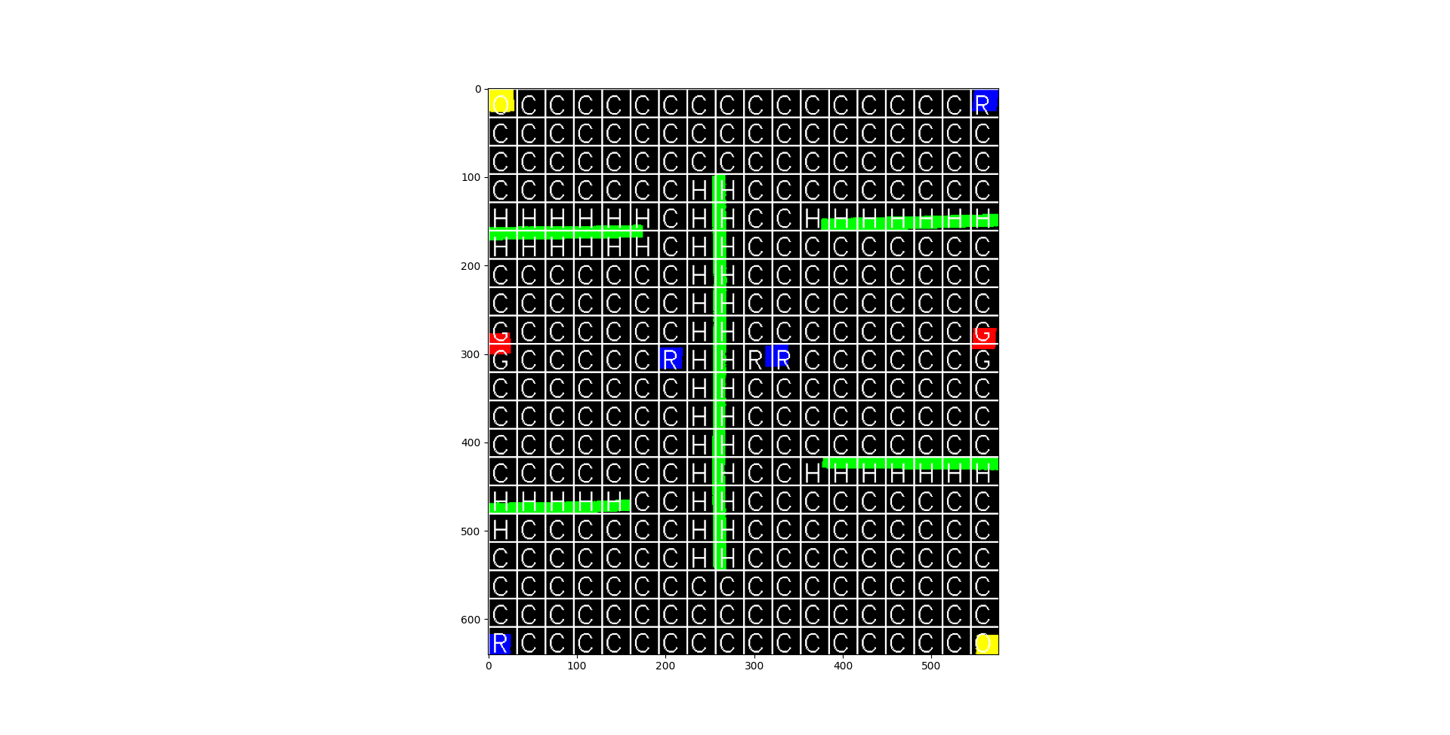
Construct map of viable travel areas

Slide 15
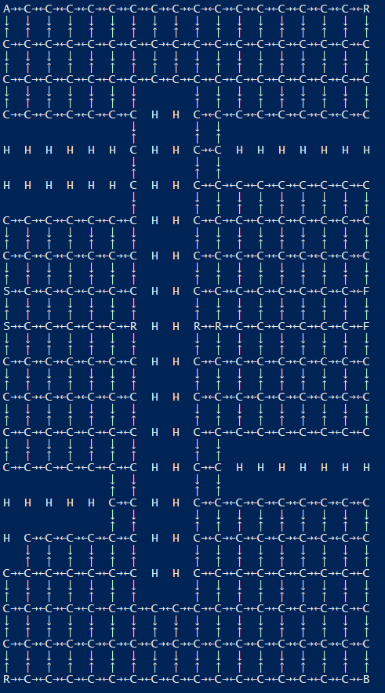

Create automata (FSM) of valid physical paths
Premature Dijkstra's Algorithm Example

Slide 16
Construct LTL formula
LTL Formula: (!r U a) && F(b)
U: Until
F(): Eventually
Translation: Do not r (refuel) until we reach a (objective a) and eventually reach b (objective b)

Slide 17
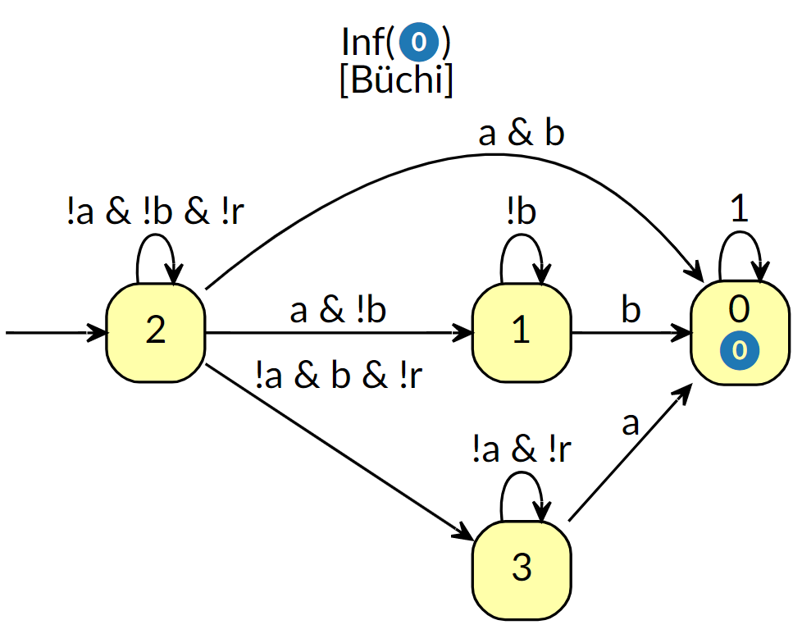
Convert LTL Formula to Automata
LTL Formula: (!r U a) && F(b)
Python Library: Spot

Slide 18
Construct LTL formula
LTL Formula: G(X(X(X(r)))) && F(a) && F(b)
G(): Always
X(): Next
Literal Translation: Always visit refuel area in the state after the next state of the next state of the current state
Translation: Always visit refuel area within next 3 states.

Slide 19
Construct LTL formula
LTL Formula: G(X(X(X(r))) || X(X(r)) || X(r)) && F(a) && F(b)
F(): Eventually
Translation: Eventually visit a and Eventually visit b

Slide 20
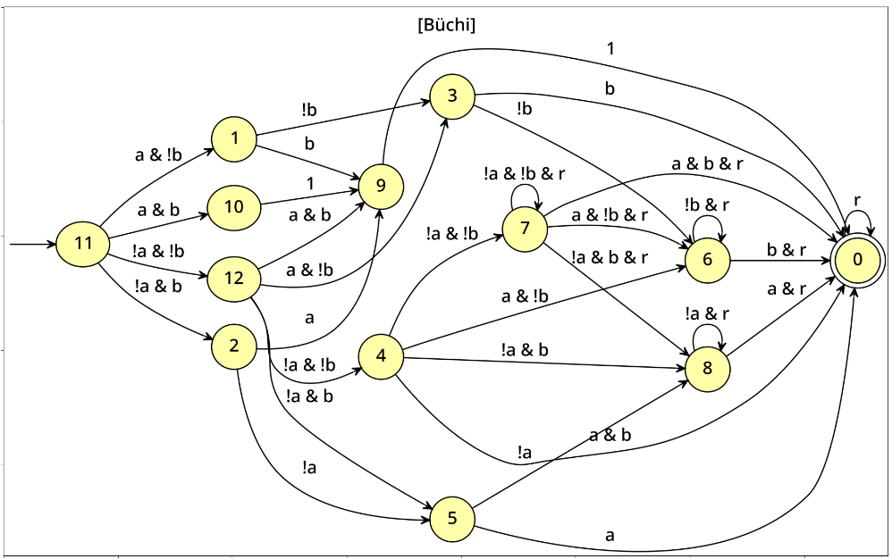
Construct LTL formula
LTL Formula: G(X(X(X(r))) || X(X(r)) || X(r)) && F(a) && F(b)

Slide 21
Construct LTL formula
LTL Formula: G(X(X(X(r))) || X(X(r)) || X(r)) && F(a) && F(b)

Slide 22
Construct LTL formula
LTL Formula: G(X₁₅(r)) && F(a) && F(b)
Translation:

Slide 23
Calculate product automata to construct valid paths
States in physical map FSM: 18x20 = 360
States in LTL Buchi automata: 4
Total states: 360x4 = 1440
x-y,j :
x,y if ∃ cell_{x,y}
, j ∈ Q_{ltl}
Path from u-v,i to x-y,j exists if path from u-v to x-y exists AND path from i to j exists given state at x-y

Slide 24
Apply Dijkstra's algorithm to find shortest path

Slide 25
Strip states to physical paths
Current State Format: f”{phys_x}-{phys_y},{ltl_state}”
int(.split(“-”)[0])
.split(“,”)[0]
int(.split(“-”)[1])
x, y

Slide 26
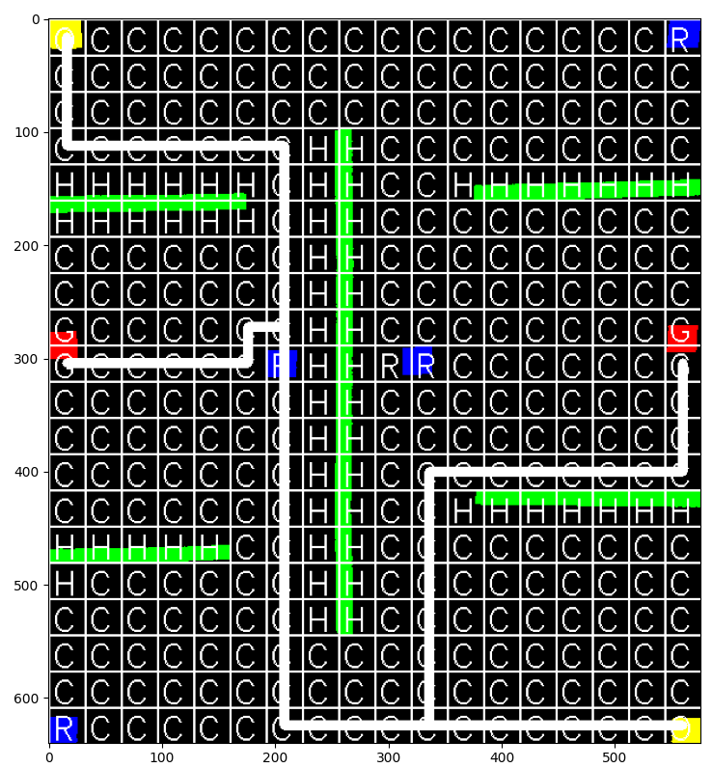
Draw path on world

Slide 27
Sources
Spot: https://spot.lrde.epita.fr/
OpenCV: https://opencv.org/
Code: https://github.com/aryan-gupta/grad-thesis/tree/main/coar-lab-presentation

Slide 28
Questions?

